Slide 1
Neural Networks
Oliver Temple

Slide 2

Overview
Objectives
Types of Neural Networks
How Neural Networks Work
Coding a Neural Network
Results
Conclusion

Slide 3
Objectives
Explore the different types of neural network models
Explore the uses of different types of neural network models
Explore how a neural network works from a high level
Explore how to use a neural network to classify handwritten digits from 0-9
Code a neural network to classify handwritten digits from 0-9

Slide 4

Types of Neural Networks
Perceptron
Feed Forward Neural Network
Multi-layer Perceptron
Convolutional Neural Network

Slide 5
Types of Neural Networks
Perceptron
Feed Forward Neural Network
Multi-layer Perceptron
Convolutional Neural Network

Slide 6
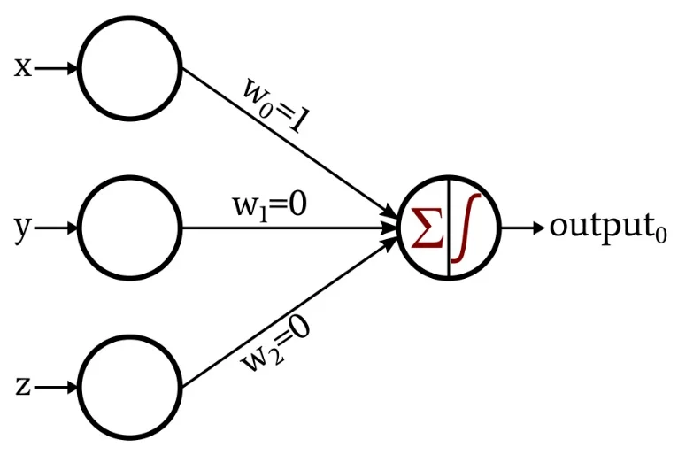

Perceptron
Simplest component of a neural network
Inputs between 0 and 1
$y=σ(W⋅x+b)$
Where $y$ is the output, $W$ is a vector of the weights, $x$ is a vector of the inputs, $b$ is the bias and $σ$ is the activation function.

Slide 7
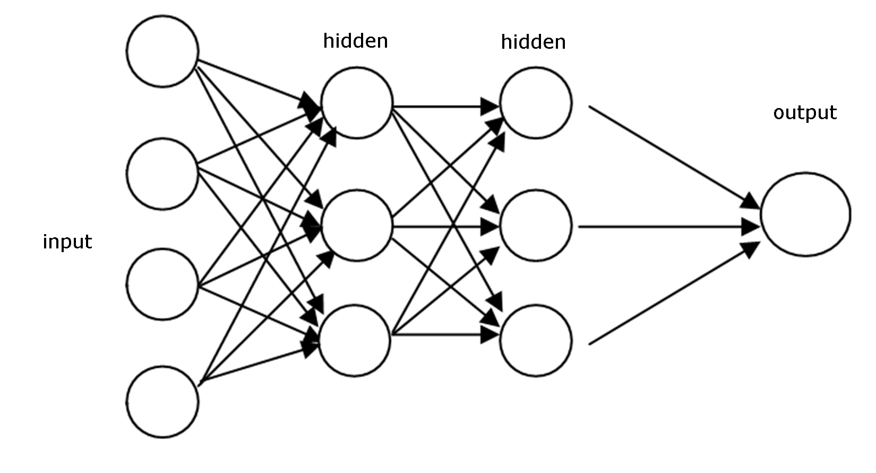

Feed Forward Neural Network
Set of interconnected layers
Linear classification only
$y_{n}=σ(W_{n}⋅y_{n−1}+b_{n})$
Where $y_{n}$ is the output of the nth layer, $W_{n}$ is the weight matrix of the nth layer, $y_{n−1}$ is the output vector of the previous layer, $b_{n}$ is the bias vector for the nth layer and $σ$ is the activation function

Slide 8
Multi-layer Perceptron
Set of interconnected layers
Linear classification only
$y_{n}=σ(W_{n}⋅y_{n−1}+b_{n})$
Where $y_{n}$ is the output of the nth layer, $W_{n}$ is the weight matrix of the nth layer, $y_{n−1}$ is the output vector of the previous layer, $b_{n}$ is the bias vector for the nth layer and $σ$ is the activation function

